Slide 1

Space X Falcon 9 Landing Analysis
Ömer Ekmen
Aug. 2023

Slide 2
Outline
01
02
03
04
05
06
Executive Summary
Introduction
Methodology
Results
Conclusion
Appendix

Slide 3
Executive Summary
Summary of Methodologies:
This project follows these steps:
Data Collection
Data Wrangling
Exploratory Data Analysis
Interactive Visual Analytics
Predictive Analysis (Classification)
Summary of Results:
This project produced the following outputs and visualizations:
Exploratory Data Analysis (EDA) results
Geospatial analytics
Interactive dashboard
Predictive analysis of classification models

Slide 4

Introduction
SpaceX has emerged as a pathfinder, revolutionizing the field of rocket technology and launch economics in the enormous field of space exploration, where every gram of payload and every dollar of investment matter. The Falcon 9 rocket, a symbol of innovation and reusability that has changed the dynamics of reasonably priced space travel, is at the center of this transition. The Falcon 9's capability to land and then reuse its first stage is evidence of SpaceX's determination to completely transform the space industry.
Within the larger field of predictive analytics and aerospace engineering, the SpaceX Falcon 9 First Stage Landing Analysis Project is a significant undertaking. This project's main objective is to use data science to predict how the Falcon 9 first stage landing will turn out. We can evaluate the cost-effectiveness of each launch and offer crucial information for decision-making in the space sector by correctly forecasting whether the first stage will successfully return and land.

Slide 5
Methodology
Data Collection
The project begins with the collection of pertinent data by making GET requests to the SpaceX REST API and employing web scraping techniques. This step is pivotal in amassing a substantial dataset that encapsulates the essential variables related to Falcon 9 launches and landings.
Data Wrangling
Data wrangling is a crucial step in the SpaceX Falcon 9 Landing Analysis project. It involves:
Handling Missing Values: The .fillna() method replaces missing values with appropriate placeholders, ensuring data consistency.
Insights with .value_counts(): This method helps us understand:
Number of launches at each site.
Occurrence of each orbit type.
Occurrence of mission outcomes for each orbit type.
Creating Landing Outcome Label: A binary label is created to signify successful (1) or unsuccessful (0) booster landings. This label is pivotal for training classification models.
Exploratory Data Analysis
The project delves deeper into the data through exploratory data analysis, leveraging SQL queries for advanced data manipulation. Employing Pandas and Matplotlib, the project constructs visualizations to illuminate relationships between variables and identify patterns within the dataset.
Interactive Visual Analytics
Taking the analysis further, the project incorporates geospatial analytics using Folium, enabling the visualization of geographical aspects of launches. Additionally, the creation of an interactive dashboard using Plotly Dash enhances data representation and engagement, fostering a dynamic exploration of the dataset.
Data Modelling and Evaluation
The core of the project revolves around data modeling and evaluation. Scikit-Learn comes into play for pre-processing tasks like standardizing data, followed by the division of the dataset into training and testing subsets using train_test_split. Multiple classification models are trained on the data, allowing for the prediction of landing outcomes. The use of GridSearchCV helps identify optimal hyperparameters, enhancing the models' performance. The project culminates in the creation of confusion matrices and the assessment of classification model accuracy, providing a clear understanding of the model's predictive power.

Slide 6
Data Collection
Data Collection Process
Access SpaceX REST API
Retrieve Launch and Landing Data
Perform Web Scraping
Gather Additional Information
Combine and Organize Gathered Data
Structured Dataset for Analysis
Accessing SpaceX REST API: The SpaceX REST API is queried to retrieve detailed information about Falcon 9 launches and landing outcomes. This includes launch site, orbit, mission success, and landing outcome data.
Web Scraping for Supplementary Data: In cases where certain data isn't available through the API, web scraping techniques are employed to gather additional information, such as launch site details, mission objectives, and other relevant attributes.
Combining and Structuring Data: The collected data is organized into a structured dataset that captures key variables required for the analysis, such as launch site, orbit, and mission outcome.

Slide 7
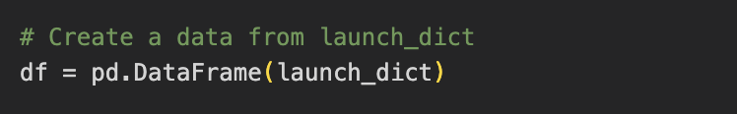
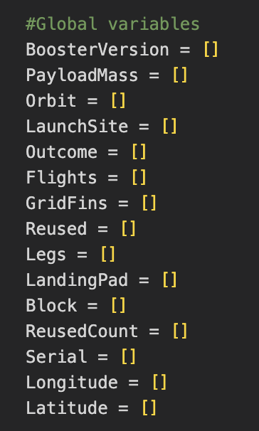
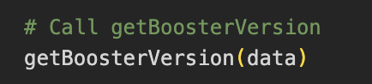
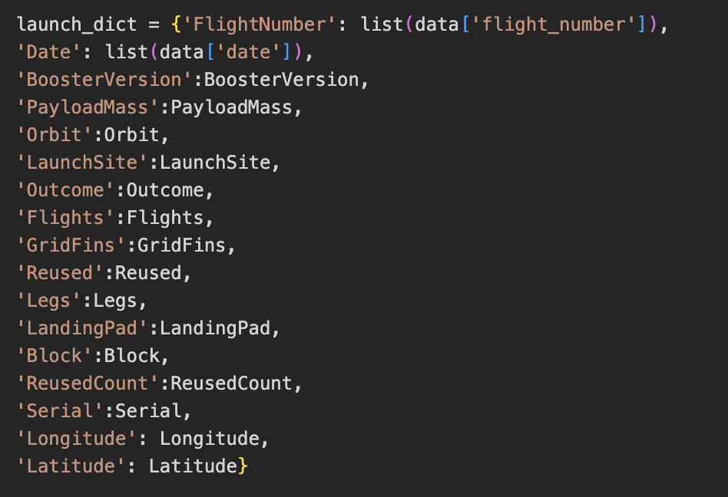
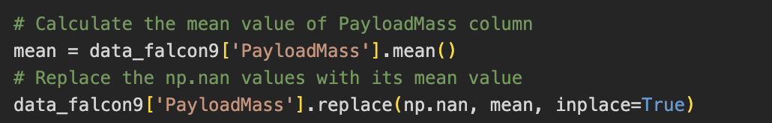
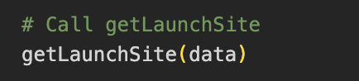
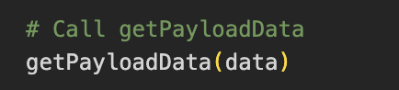
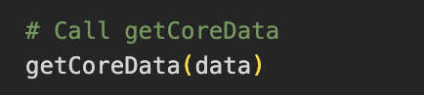
Data Collection – SpaceX API
Obtaining launch-related data from the SpaceX API, such as details on the rocket launched, the payload delivered, launch specs, landing specifications, and landing outcome.
1
Make a GET response to the SpaceX REST API
Convert the response to a .json file then to a Pandas DataFrame
3
Create a Pandas DataFrame from the constructed dictionary dataset
4
Filter the DataFrame to only include Falcon 9 launches
Reset the FlightNumber column
Replace missing values of PayloadMass with the mean PayloadMass value
2
Use custom logic to clean the data
Define lists for data to be stored in
Call custom functions to retrieve data and fill the lists
Use these lists as values in a dictionary and construct the dataset
Github Link

Slide 8
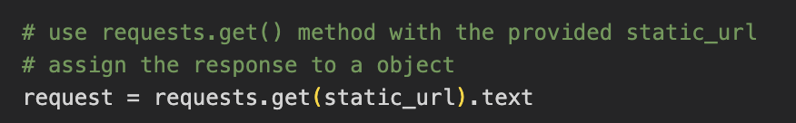
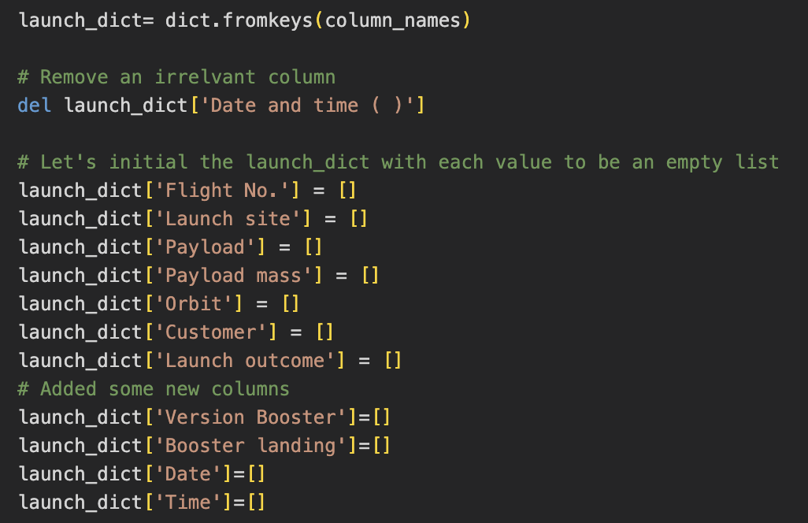
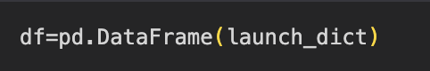
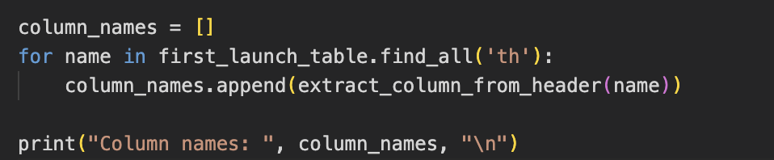
Data Collection – Web Scraping
Our approach involves employing web scraping techniques to extract comprehensive historical launch records of Falcon 9. Specifically, we target the relevant information from the Wikipedia page titled "List of Falcon 9 and Falcon Heavy launches." Through this process, we aim to accumulate a thorough dataset detailing the launch history of Falcon 9 rockets.
1
Request the HTML page from the static URL
Assign the response to an object
4
Use the column names as keys in a dictionary
Use custom functions and logic to parse all launch tables to fill the dictionary values
2
Create a BeautifulSoup object from the HTML response object
Find all tables within the HTML page
5
Convert the dictionary to a Pandas DataFrame ready for export
3
Collect all column header names from the tables found within the HTML page
Github Link

Slide 9
Data Wrangling
The SpaceX dataset incorporates diverse launch facilities, with each specific location being represented in the "LaunchSite" column. Meanwhile, individual launches are tailored to achieve specific orbits, with various well-defined orbit types exemplified in the figure below. These orbit types are captured in the "Orbit" column of the dataset.
The landing outcome is shown in the “Outcome” column:
True Ocean – the mission outcome was successfully landed to a specific region of the ocean
False Ocean – the mission outcome was unsuccessfully landed to a specific region of the ocean.
True RTLS – the mission outcome was successfully landed to a ground pad
False RTLS – the mission outcome was unsuccessfully landed to a ground pad.
True ASDS – the mission outcome was successfully landed to a drone ship
False ASDS – the mission outcome was unsuccessfully landed to a drone ship.
None ASDS and None None – these represent a failure to land.
Github Link

Slide 10
Data Wrangling
Initial Data Exploration:
Using the .value_counts() method to determine the following:
- Number of launches on each site
- Number and occurrence of each orbit
- Number and occurrence of landing outcome per orbit type
5
Convert the dictionary to a Pandas DataFrame ready for export
1
Request the HTML page from the static URL
Assign the response to an object
Github Link

Slide 11
EDA with Data Visualization
Summarize what charts were plotted and why you used those charts
Add the GitHub URL of your completed EDA with data visualization notebook, as an external reference and peer-review purpose

Slide 12
EDA with SQL
Using bullet point format, summarize the SQL queries you performed
Add the GitHub URL of your completed EDA with SQL notebook, as an external reference and peer-review purpose

Slide 13
Build an Interactive Map with Folium
Summarize what map objects such as markers, circles, lines, etc. you created and added to a folium map
Explain why you added those objects
Add the GitHub URL of your completed interactive map with Folium map, as an external reference and peer-review purpose

Slide 14
Build a Dashboard with Plotly Dash
Summarize what plots/graphs and interactions you have added to a dashboard
Explain why you added those plots and interactions
Add the GitHub URL of your completed Plotly Dash lab, as an external reference and peer-review purpose

Slide 15
Predictive Analysis (Classification)
Summarize how you built, evaluated, improved, and found the best performing classification model
You need present your model development process using key phrases and flowchart
Add the GitHub URL of your completed predictive analysis lab, as an external reference and peer-review purpose

Slide 16
Results
Exploratory data analysis results
Interactive analytics demo in screenshots
Predictive analysis results

Slide 17
Section 2

Slide 18
Flight Number vs. Launch Site
Show a scatter plot of Flight Number vs. Launch Site
Show the screenshot of the scatter plot with explanations

Slide 19
Payload vs. Launch Site
Show a scatter plot of Payload vs. Launch Site
Show the screenshot of the scatter plot with explanations

Slide 20
Success Rate vs. Orbit Type
Show a bar chart for the success rate of each orbit type
Show the screenshot of the scatter plot with explanations

Slide 21
Flight Number vs. Orbit Type
Show a scatter point of Flight number vs. Orbit type
Show the screenshot of the scatter plot with explanations

Slide 22
Payload vs. Orbit Type
Show a scatter point of payload vs. orbit type
Show the screenshot of the scatter plot with explanations

Slide 23
Launch Success Yearly Trend
Show a line chart of yearly average success rate
Show the screenshot of the scatter plot with explanations

Slide 24
All Launch Site Names
Find the names of the unique launch sites
Present your query result with a short explanation here

Slide 25
Launch Site Names Begin with 'CCA'
Find 5 records where launch sites begin with `CCA`
Present your query result with a short explanation here

Slide 26
Total Payload Mass
Calculate the total payload carried by boosters from NASA
Present your query result with a short explanation here

Slide 27
Average Payload Mass by F9 v1.1
Calculate the average payload mass carried by booster version F9 v1.1
Present your query result with a short explanation here

Slide 28
First Successful Ground Landing Date
Find the dates of the first successful landing outcome on ground pad
Present your query result with a short explanation here

Slide 29
Successful Drone Ship Landing with Payload between 4000 and 6000
List the names of boosters which have successfully landed on drone ship and had payload mass greater than 4000 but less than 6000
Present your query result with a short explanation here

Slide 30
Total Number of Successful and Failure Mission Outcomes
Calculate the total number of successful and failure mission outcomes
Present your query result with a short explanation here

Slide 31
Boosters Carried Maximum Payload
List the names of the booster which have carried the maximum payload mass
Present your query result with a short explanation here

Slide 32
2015 Launch Records
List the failed landing_outcomes in drone ship, their booster versions, and launch site names for in year 2015
Present your query result with a short explanation here

Slide 33
Rank Landing Outcomes Between 2010-06-04 and 2017-03-20
Rank the count of landing outcomes (such as Failure (drone ship) or Success (ground pad)) between the date 2010-06-04 and 2017-03-20, in descending order
Present your query result with a short explanation here

Slide 34
Section 3

Slide 35
<Folium Map Screenshot 1>
Replace <Folium map screenshot 1> title with an appropriate title
Explore the generated folium map and make a proper screenshot to include all launch sites’ location markers on a global map
Explain the important elements and findings on the screenshot

Slide 36
<Folium Map Screenshot 2>
Replace <Folium map screenshot 2> title with an appropriate title
Explore the folium map and make a proper screenshot to show the color-labeled launch outcomes on the map
Explain the important elements and findings on the screenshot

Slide 37
<Folium Map Screenshot 3>
Replace <Folium map screenshot 3> title with an appropriate title
Explore the generated folium map and show the screenshot of a selected launch site to its proximities such as railway, highway, coastline, with distance calculated and displayed
Explain the important elements and findings on the screenshot

Slide 38
Section 4

Slide 39
<Dashboard Screenshot 1>
Replace <Dashboard screenshot 1> title with an appropriate title
Show the screenshot of launch success count for all sites, in a piechart
Explain the important elements and findings on the screenshot

Slide 40
<Dashboard Screenshot 2>
Replace <Dashboard screenshot 2> title with an appropriate title
Show the screenshot of the piechart for the launch site with highest launch success ratio
Explain the important elements and findings on the screenshot

Slide 41
<Dashboard Screenshot 3>
Replace <Dashboard screenshot 3> title with an appropriate title
Show screenshots of Payload vs. Launch Outcome scatter plot for all sites, with different payload selected in the range slider
Explain the important elements and findings on the screenshot, such as which payload range or booster version have the largest success rate, etc.

Slide 42
Section 5

Slide 43
Classification Accuracy
Visualize the built model accuracy for all built classification models, in a bar chart
Find which model has the highest classification accuracy

Slide 44
Confusion Matrix
Show the confusion matrix of the best performing model with an explanation

Slide 45
Conclusions
Point 1
Point 2
Point 3
Point 4
…

Slide 46
Appendix
Include any relevant assets like Python code snippets, SQL queries, charts, Notebook outputs, or data sets that you may have created during this project

